Slide 1
ROTARY DISTRICT TRAINING ASSEMBLY (DISTAS ’21)
CONFLICT PREVENTION
& RESOLUTION
2nd May 2021
1

Slide 2
SESSION 2
OPTIONS TO MANAGING CONFLICTS
Rtn ANIL CHANGAROTH
RC PANDAN VALLEY
(SINGAPORe)
District 3310 Committees
2020-2021 2021-2022
Youth Service (Regional Chair – Singapore) (1) District Joint Rotaract Committee Co Chair
Elevate Rotaract Task Force (2) Rotary Youth Leaders Award (Regional Chair – S’pore)
Fellowship (3) Vocational Service (Regional Deputy Chair – Spore)
(4) Constitution, Resolution & Credentials
(

Slide 3
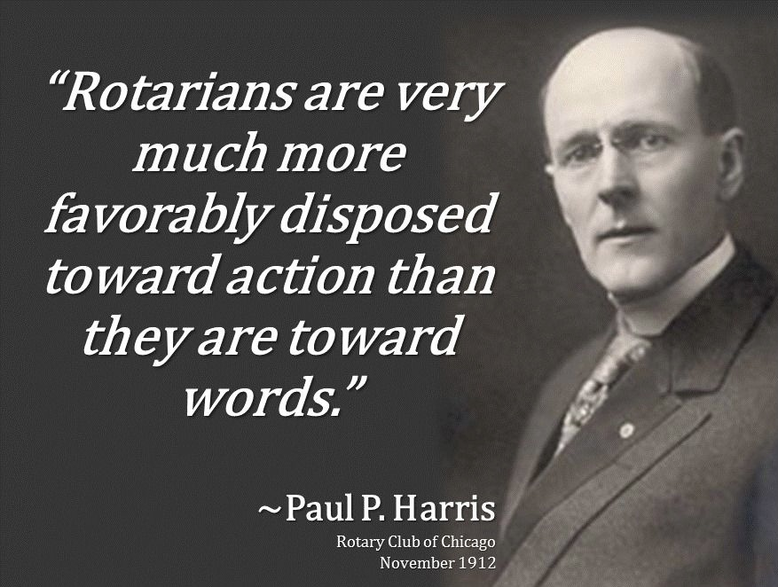
CONFLICT A serious disagreement between two parties, resulting in a negative consequence
7/20

Slide 4
CONSENSUAL AVOIDANCE / RESOLUTION
CONCILIATION –
parties voluntarily enters into dialogue, at times with assistance of a 3rd party
NEGOTIATION – an interactive communication process; sharing information and bridging differences of opinions; modifying expectations and requirements
9/20

Slide 5
MEDIATION
A neutral 3rd party facilitating (at times evaluating) parties’ negotiations to help them arrive at a mutually beneficial solution
Focusing on their Interests
and not their Positions
12/20

Slide 6
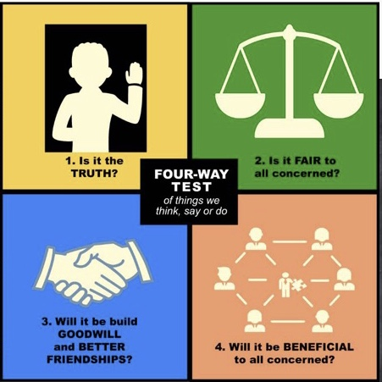
THE 4 WAY TEST THE ESSENCE OF MEDIATION
14/20

Slide 7
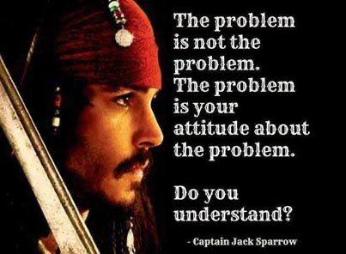
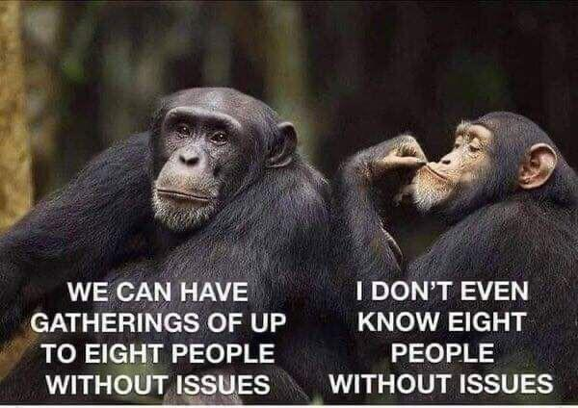
ISSUES & PROBLEMS
18/20

Slide 8
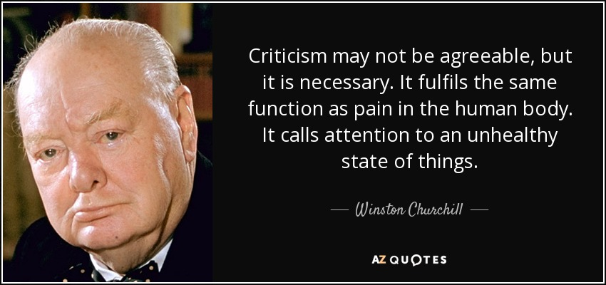
CONFRONTING ISSUES vs BEING CONFRONTATIONAL
19/20

