Slide 1
CONFLICT PREVENTION
AND
RESOLUTION

Slide 2
FELLOWSHIP – WINE AND DINE?

Slide 3
FELLOWSHIP – Every Rotarian’s Emotional Bank Account:
The Compelling Factor in Conflict Prevention & Resolution

Slide 4
A STORY
“Respecting differences and displaying sensitivity towards others!

Slide 5
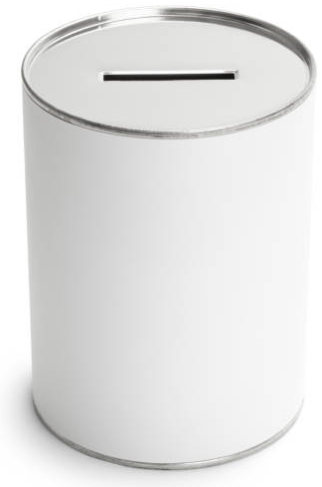
ME
EMOTIONAL BANK ACCOUNTS
HIM
DEPOSITS

Slide 6
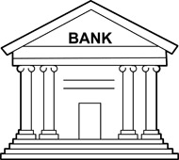
DEPOSITS
EMOTIONAL BANK ACCOUNTS
COMMERCIAL BANK
Respecting Others
Checking Accounts
Supporting Positively
Savings Accounts
Committing to Projects
Fixed Deposits
Other Positive Initiatives
Other Products
“Deposit Grows Over Time!”

Slide 7
FELLOWSHIP
“How fair are we in dealing with others…treating them with respect as fellow human beings.”
Rotary Code of Conduct

Slide 8
ME
EMOTIONAL BANK ACCOUNTS
HIM
DEPOSITS
(+)
WITHDRAWALS
(-)

Slide 9
WITHDRAWALS
EMOTIONAL BANK ACCOUNTS
COMMERCIAL BANK
Negative Comments
Broken Promises
Unconstructive Criticisms
Inappropriate Jokes
Others
“Withdrawal Undermines Relationship Over Time!”

Slide 10
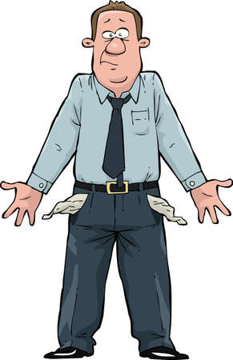
Excessive Withdrawals Result in
OVERDRAFT EMOTIONAL BANK ACCOUNT
A Story

Slide 11
EMOTIONAL BANK ACCOUNTS
DEPOSITS (+)
FELLOWSHIP is about making DEPOSITS and not WITHDRAWALS

Slide 12
EMOTIONAL BANK ACCOUNTS
DEPOSITS (+)
FELLOWSHIP is the BOND that
prevents CONFLICTS

Slide 13
Call of ACTION in
FELLOWSHIP
Keep Making DEPOSITS (+)
Q1. How can I strengthen my BOND with fellow Rotarians and the Communities I serve by making DEPOSITS?
Q2. How can I avoid conflicts by not making WITHDRAWALS?

Slide 14
Conclusion
More DEPOSITS Less CONFLICTS
ROTARIAN’S
EMOTIONAL
BANK
ACCOUNTS

Slide 15
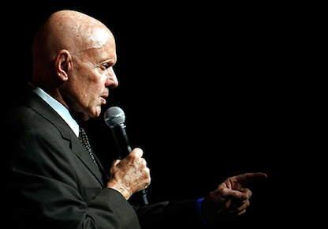
“You will never be able to truly step inside someone’s shoes
to see the world as he sees it,
until you develop the pure desire,
the strength of personal character and
Positive Emotional Bank Account.”
Stephen Covey
Writer & Thinker

