Slide 1

Council on Legislation/ Council on Resolutions –
Work Plan for 2021 - 2022
April 28, 2021

Slide 2
Our Aim
To educate better understanding on COL and COR matters to Clubs and Rotarians, so there will be greater interests to participate on COL and COR matters.
Prepare our clubs to actively participate in COR and COL affairs for the good Rotary and the District
To set an efficient system for the COL/COR Working team to support our Clubs in our District

Slide 3
What we did in 2020 ?
The District COL/COR Team was formed and met September 2020.
The COLWC started working with the clubs in our District.
Secured cooperation from all the clubs to appoint their Club COL representatives.
In Oct the COLWC put out recommendation for the 2020 Resolutions and Urgent Enactment to all the clubs.
We held the first exercise, our clubs responded and collectively voted the RI 2020 Resolutions and Urgent Enactment.
By the first week of Nov 2020 we successfully submitted the District votes.

Slide 4
Our Findings
Our Clubs lack understanding on COL and COR matters
Need for our Club representatives and COL working committee to work together
A need to understand, how to propose COL and COR proposals.
Club Representatives are encouraged to attend COL training at RI learning center..

Slide 5
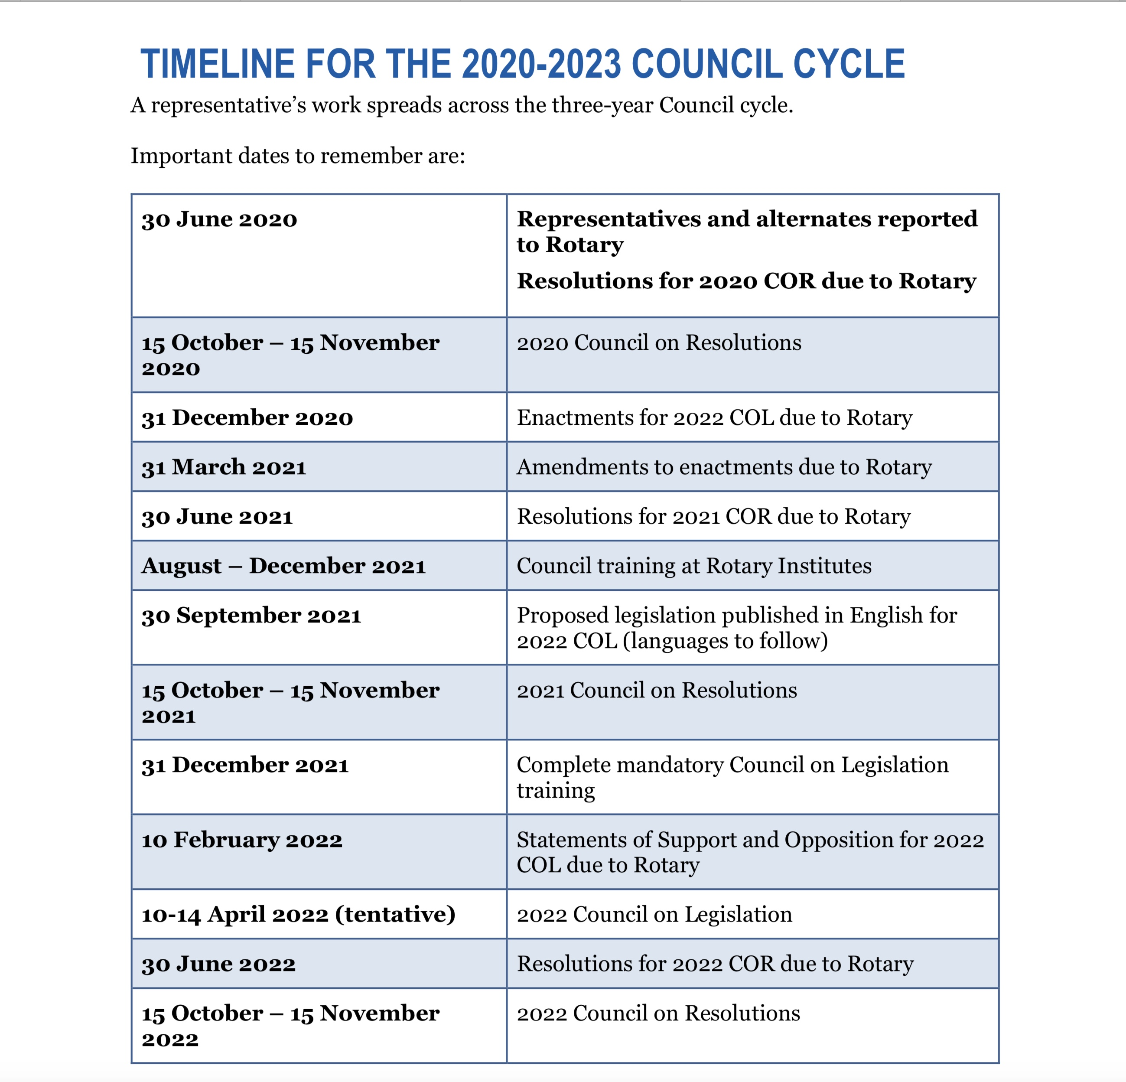

Slide 6
Council on Resolutions 2021 Planning Schedule
1
2

Slide 7
Action Plan for 2021 - 2022
Our COLWC will work actively with the clubs representatives to meet COL/COR working schedule.
More training on COL/COR to Clubs’ members
The COLWC will work with the clubs to identify area of interests for COR and COL proposals.
To hold a COL/COR seminar to share on COL/COR ideas.

Slide 8
Thank you

