Slide 1

Getting involved in decisions that shape the Rotary World
Council on Legislation
Council on Resolutions
DISTAS, APRIL 28, 2021
Title Page Option

Slide 2

subhead
4 Takeaways for today
What are the Council on Legislation and Council on
Resolutions
2. What do they do
3. What is an Enactment and what is a Resolution
4. What is your club’s role within this process

Slide 3
Role of COL and COR
Rotary's Council on Legislation and Council on Resolutions give every Rotarian the power to change Rotary. They are the system that we can all use to keep our clubs and our organization working their best and make sure they continue to enhance our members' lives and enrich our communities.
Each district elects a representative to speak for its members. The representative serves for three years and participates in both Councils.
District 3310s representative is PDG Henry Tan with PDG Michael Yee as the alternate.

Slide 4
Should you submit an item to one of the Councils?
Does it benefit the entire Rotary World or just your District or Region?
Is it an administrative matter rather than a strategic issue, priority or constitutional issue ?

Slide 5
Working Structure within our District
DISTRICT
DISTRICT
RI
D
District Advisory Committee
Council on Legislation (COL)
Rotary Clubs
District COL/R rep
Council on Resolutions (COR)
District Working Committee

Slide 6
subhead
Council on Legislation
Meets in person every three years
Representatives discuss and vote on proposed legislation
Legislation includes enactments and position statements
Enactments
If your idea would require changes to a constitutional document (the RI Constitution, RI Bylaws, or Standard Rotary Club Constitution), propose an enactment.

Slide 7
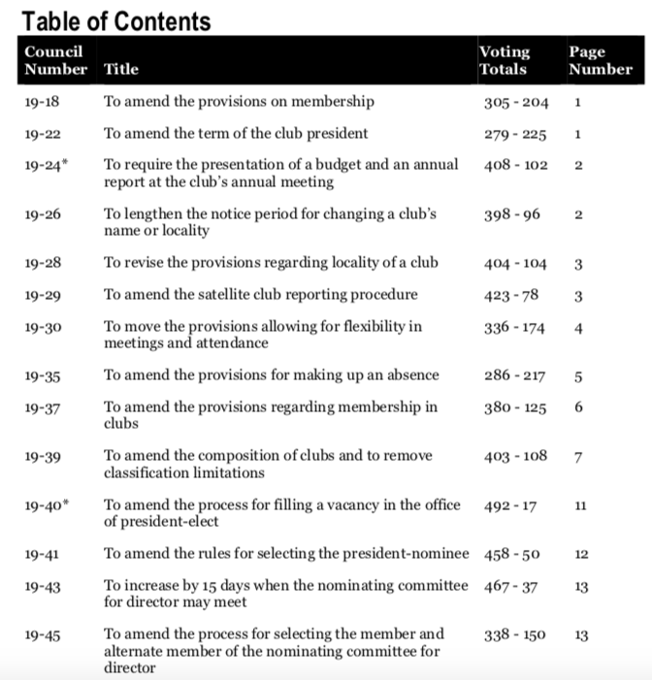

Example of Enactments (2019)

Slide 8
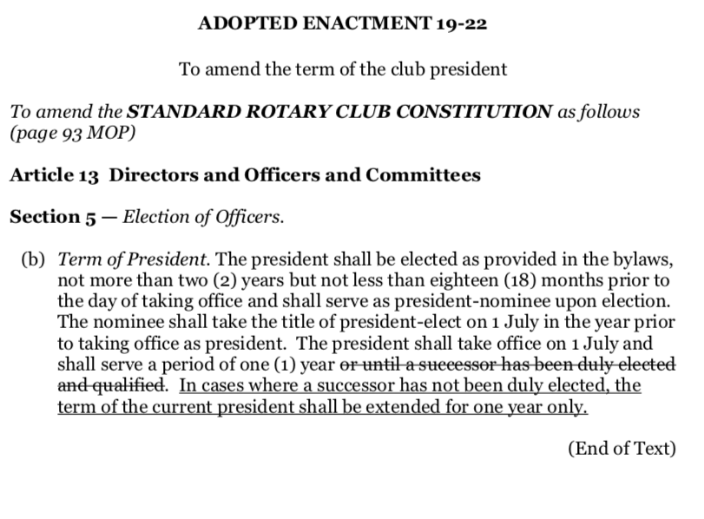
Example of Enactments (2019)

Slide 9
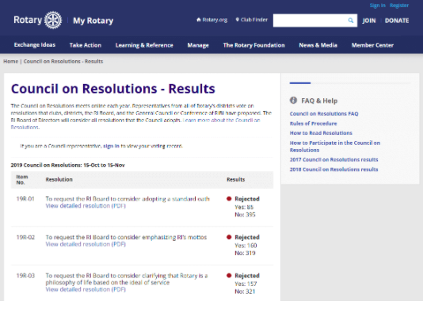
Council on Resolutions
Meets online every year
Representatives discuss and vote on proposed resolutions
Resolutions
If your idea wouldn't require changing any constitutional documents, make it a resolution. Resolutions are suggestions to the RI Board or Rotary Foundation Trustees.

Slide 10
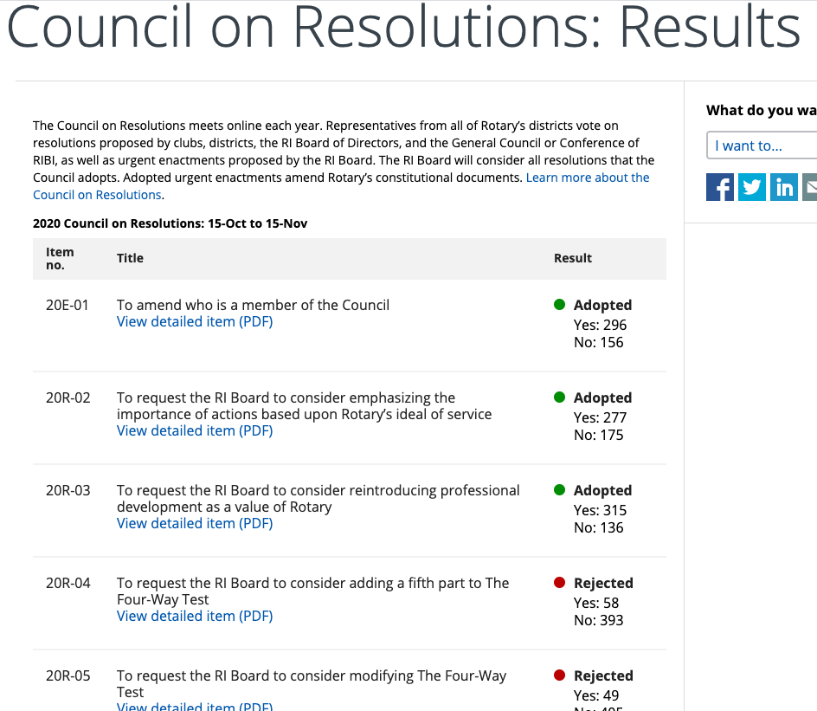
Examples of Resolutions

Slide 11
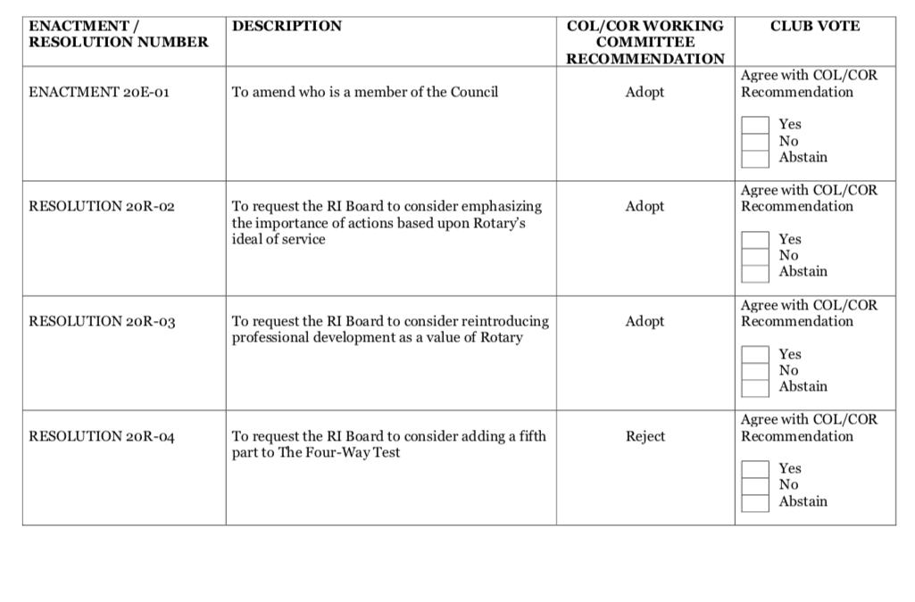
We voted last year on 30 resolutions and 1 enactment

Slide 12
We voted last year on 30 resolutions and 1 enactment

Slide 13
Who can propose changes ?
Enactments and resolutions can be proposed by:
Clubs
Districts
Rotary's Board of Directors
The Council on Legislation
The RIBI General Council or the RIBI Conference

Slide 14
When to propose changes
Resolutions
You can propose resolutions each year. Submit them by 30 June to have them voted on this year.
Enactments
Enactments are considered at the Council on Legislation, which meets every three years. Those that will be voted on in 2022 need to be submitted by 31 December 2020.

Slide 15
Resolutions or enactments from clubs
If a club proposes either a resolution or an enactment, its district must endorse the item. The district can do that through any of these:
A district conference
A district legislation meeting
A club ballot
Work with your district governor to make sure that your item is submitted by the due date.

Slide 16
Submitting items
To be considered duly proposed for the Councils, enactments and resolutions must be:
Submitted to Rotary by the due date
Submitted by a group that is allowed to propose an enactment or resolution
Endorsed by the district if the item comes from a club

Slide 17
Submitting items
Consider whether your proposed enactment or resolution would benefit all Rotarians.
Determine whether your proposed change should be a resolution or an enactment.
Write the item in the established form for an enactment or a resolution.
Get your proposed enactment or resolution endorsed by your district and submit it to Rotary International.

Slide 18
What would make an enactment defective ?
It could have multiple meanings
Other related rules or policies aren't being changed
It would violate the law
It would be impossible to administer or enforce

Slide 19
What would make a resolution defective ?
It conflicts with the constitutional documents
It can be addressed by administrative actions
It is beyond Rotary's scope

Slide 20
In Summary
Resolutions are proposals for strategic directions, priorities and focus areas for Rotary
Enactments are proposals for changes to RI’s constitution, Bylaws or Standard Club Constituition
Clubs in our District can propose Resolutions and Enactments which need to be voted on and endorsed at a District Conference, District Legislation meeting or by Club Ballot
Clubs in our district can vote on resolutions and enactments coming from RI
The District COL/R rep working with the Advisory Council and the Working Committee will guide you through this process
There has been a work plan developed for our District outlining important dates and milestones ( PDG Henry will present this)

Slide 21
PDGs Advisory & Reviewing Committee:
Roles & Responsibility:
To provide an advisory role on COL and COR matters.
To assist in the final review of all future proposals to COL and COR by the District working Committee, after ground work and process have been done by the Working team, along with all the clubs in the District, before any presentation for endorsement at DISCON.
PDG Lim Hock Teck
PDG Edward Sung Burongoh
PDG Datuk Zainie Abdul Aucusa
PDG Michael Yee ( Alternate COLR)

Slide 22
Regional COL/COR Working Committee: (working with our clubs)
PDG Henry Tan (COLR)
PP Freddie Lee (Johore)
PP Quek Kia Ping (Malacca)
PP CP Lim (Sabah and Brunei)
PP Dr. John Chan (Sarawak)
PP Jeyan Nadarajah (Singapore)
Roles and Responsibility:
To assist Clubs in our District to understand matters on COL and COR.
To provide an on-time update on COL and COR related matters, whenever there is any new proposal from RI
To work closely with the clubs in our District to be better prepared for future submission when feasible of new enactment or proposed resolution by our District to Rotary International.
To organize annual review sessions with our clubs in the District and gather feedback on possible improvement to RI Constitutional documents, RI Bylaws, Standard Rotary Club constitution, and Rotary Code of Policy.

Slide 23
Thank you for your attention
Thank
Contacts:
PDG Henry Tan (COL/R) henrytkh@yahoo.com
PP Freddie Lee (Johore) freddie@umland.com.my
PP Quek Kia Ping (Malacca) jmcomment726@gmail.com
PP CP Lim (Sabah and Brunei) gigapin@gmail.com
PP Dr. John Chan (Sarawak) johnchan@chemsain.com
PP Jeyan Nadarajah (Singapore) jeyan.nad@gmail.com

Slide 24
QUESTIONS

