Slide 1
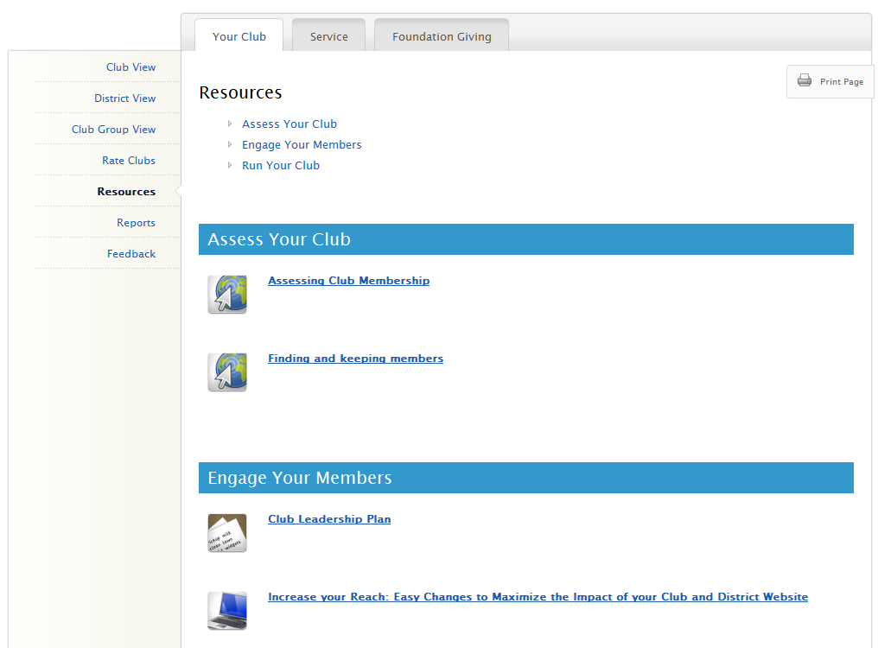
Introduction to Rotary Club Central
Entering Goals
District-level Features
Questions
Notes:
I’m happy to be here today to show you the features of the online goal-setting tool, Rotary Club Central.
This new tool will help club and district leaders to monitor club progress and achievements in three key performance areas: membership initiatives, service activities, and Rotary Foundation giving.
Rotary Club Central is available to all Rotarians, but has additional features depending on your officer role.
Today, we will cover the following…
-We’ll start with a tour of what everyone can see in Rotary Club Central. (CLICK)
-Then, we’ll go into who can enter goals, and how to enter them. (CLICK)
-Next, we’ll explore the features available to district level officers. (CLICK)
-Finally, you’ll have the chance to ask any questions that weren’t covered. (CLICK)

Slide 2
What’s in it for clubs?
One-stop shop
Eliminates paper forms
Fosters continuity in leadership
Enable clubs to track their progress
Creates transparency
Showcases the important work that Rotary clubs do worldwide
District-level Features
Notes:
Why should clubs use Rotary Club Central?
It’s a one-stop shop. It provides access to all the data that was previously available from several reports.
It eliminates some paper. It replaces paper forms for membership and Rotary Foundation goals as well as the Planning Guide for Effective Rotary Clubs.
It fosters continuity in leadership. Club leaders change annually, so by offering them the ability to see a history of goals and achievements, it creates consistency among leaders.
It enables clubs to track their progress. Club leaders can determine whether the goals they’ve set are realistic and make changes if needed.
It creates transparency. All club members are able to see club goals.
It showcases the important work that Rotary clubs do worldwide. Until now, Rotary has not had a vehicle for collecting information about the millions of service projects that Rotarians undertake. With Rotary Club Central, clubs can document the details of their projects, such as the number of volunteers and volunteer hours and a list of in-kind donations.

Slide 3
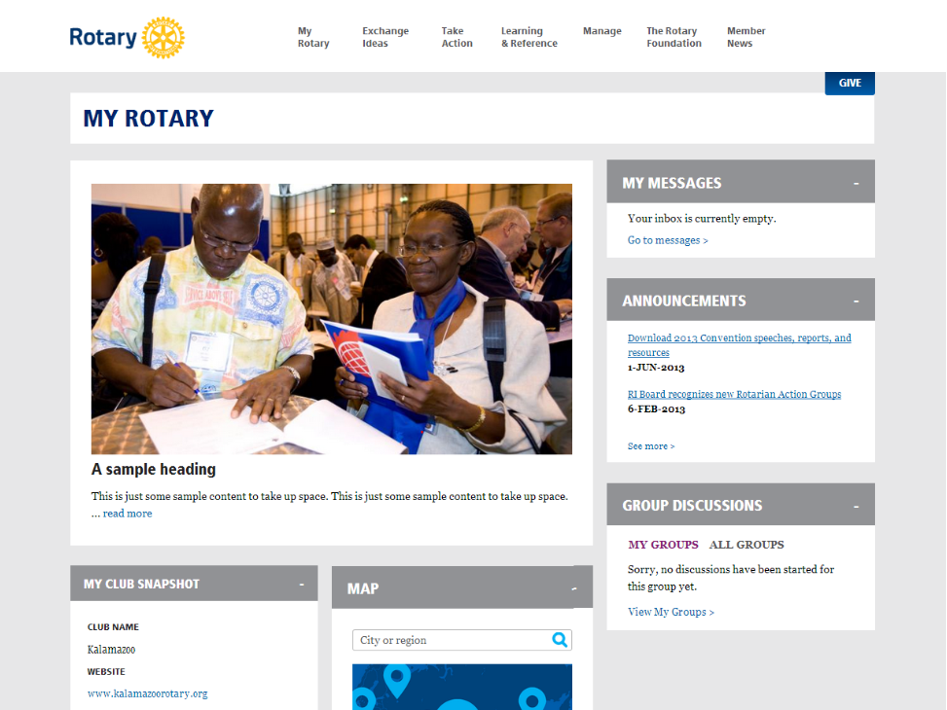
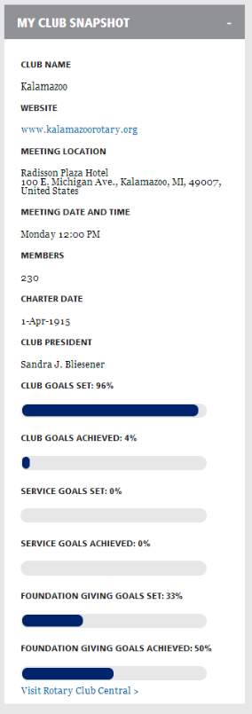
Notes:
There are a few ways to access Rotary Club Central from the new website. The most direct way is from the “My Rotary” page where you will see “My Club Snapshot.” (CLICK)
From here, you can see some of your club’s details (such as meeting location, website, charter date, members, etc.)
You can also see a summary of how many goals your club has set and achieved in each section of Rotary Club Central.
At the bottom of the club snapshot, you can click “Visit Rotary Club Central” to start viewing and editing goals. (CLICK) It can also be accessed from the “Project Lifecycle” under Take Action, or “Club and District Administration” under Manage.

Slide 4
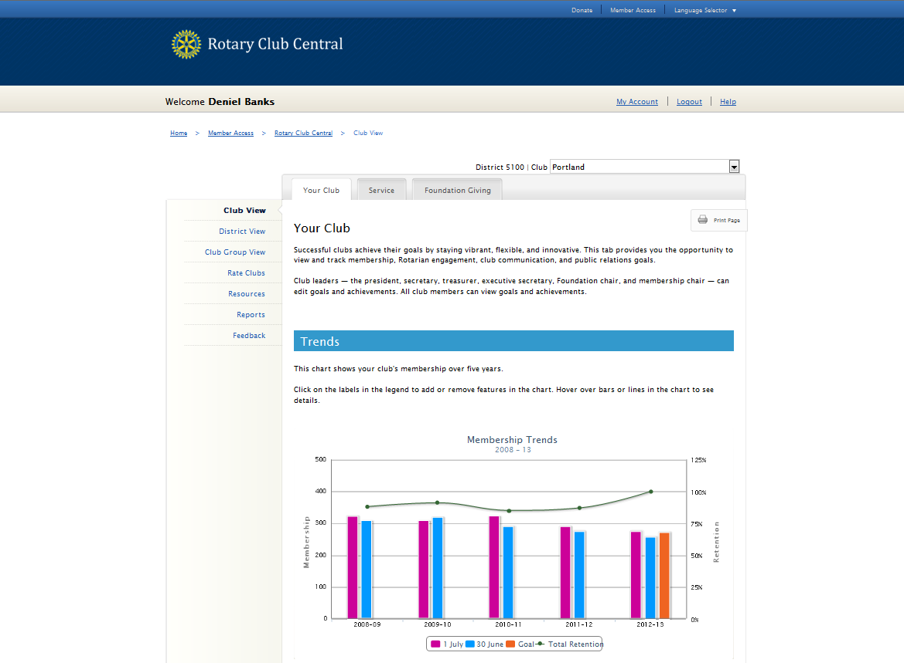
John Q. Rotarian
District: 0000 | Club: Your Club
Notes:
You will always begin at the Your Club tab.
(CLICK)
You can see that in addition to Your Club, there are tabs for Service and Foundation Giving
For Your Club, we start with the Trends section which shows your club’s membership retention over the last five years.

Slide 5
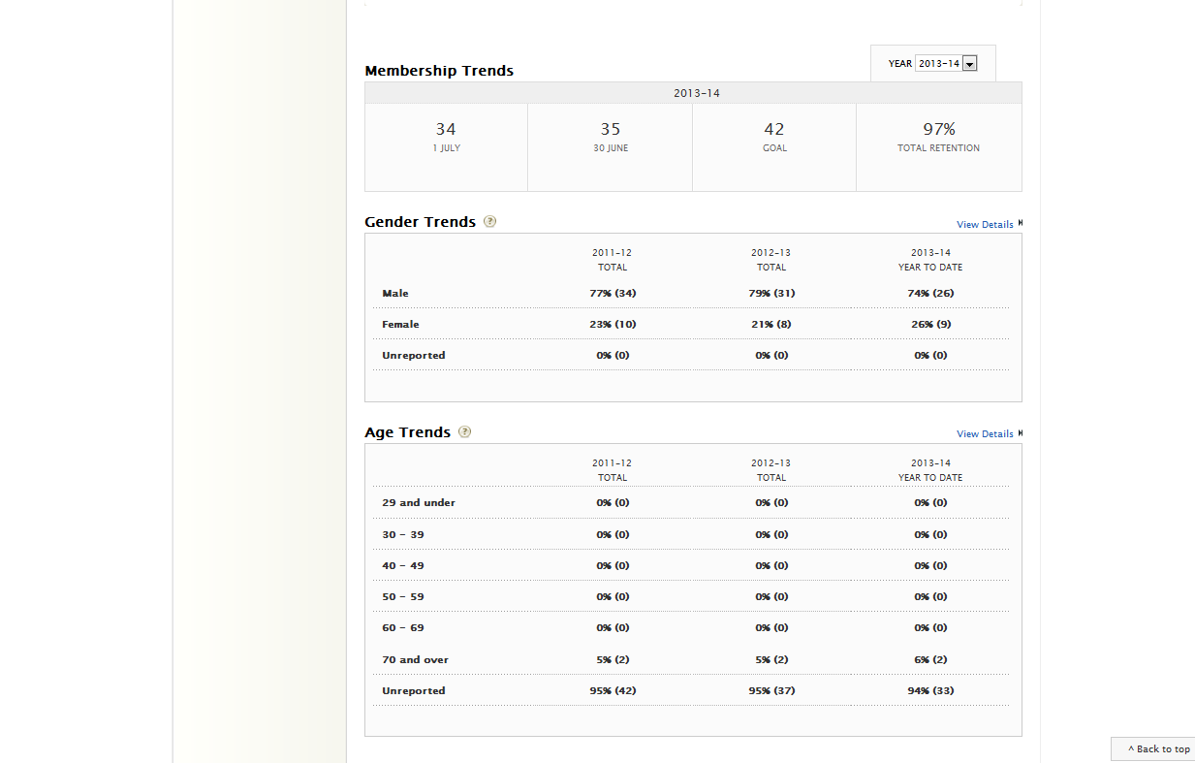
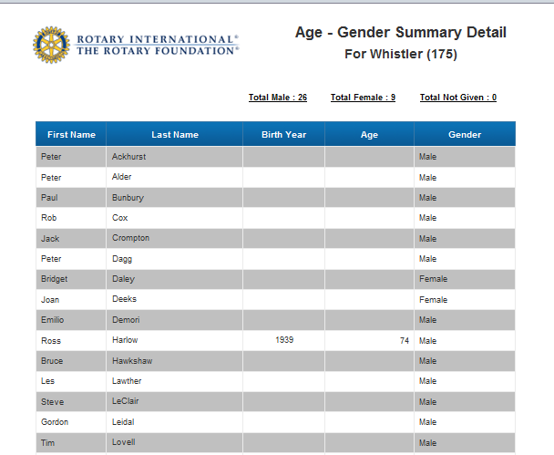
2001 1965
1909
1979
1966
1947
1977
1962
12 48
104
34
47
66
36
51
Membership Trends
Start and End Dates (5 year trends) Gender (3 year trends) Age Trends (3 year trends)
Notes:
Below that are more membership trends, starting with the membership start and end dates over the past 5 years, as well as gender and age trends over the last 3 years. While these aren’t goals, seeing the trends can help your club strive for a more balanced membership.

Slide 6
Your Club
Membership Retention Rotarian Engagement Club Communication Public Relations
Notes:
As you scroll down further, clubs can set four main goals in this section:
(CLICK) -Membership Retention -Rotarian Engagement
-Club Communication
-and Public Relations. (speaker may wish to give examples for each major goal)

Slide 7
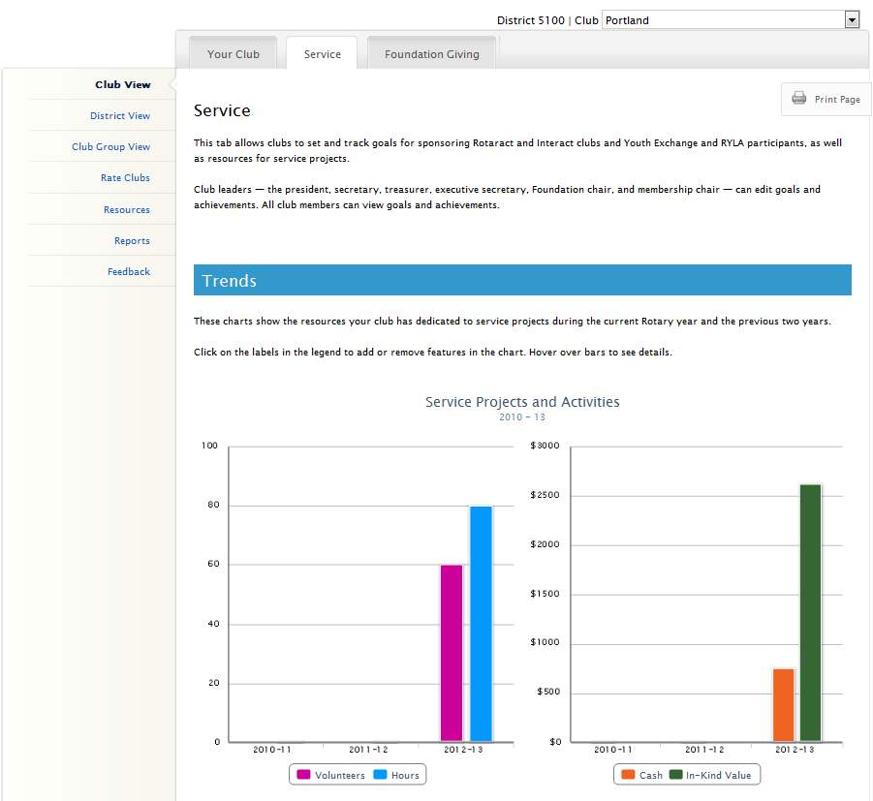
Notes:
Moving on to the Service tab, you’re presented with a trend graph displaying a breakdown of the impact achieved from your club’s service projects and activities over the last three years. The four impact measures are number of volunteers, total volunteer hours, cash donations, and in-kind donations.

Slide 8
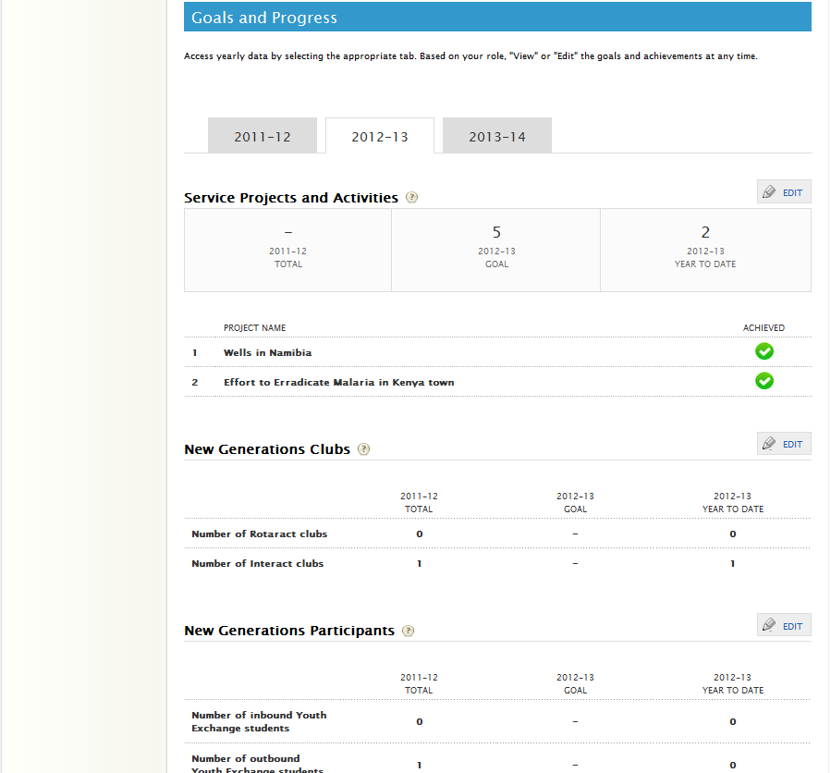
Service
Service Projects and Activities New Generations Clubs New Generations Participants
Notes:
Scrolling down, there are three main goals here, which are;
(CLICK)
-Service Projects and Activities (which can be imported from or shared with Rotary Showcase)
-New Generations Clubs (which includes sponsoring Rotaract and Interact clubs),
-and New Generations Participants (which covers Youth Exchange and RYLA).
(speaker may wish to give examples for each major goal)

Slide 9
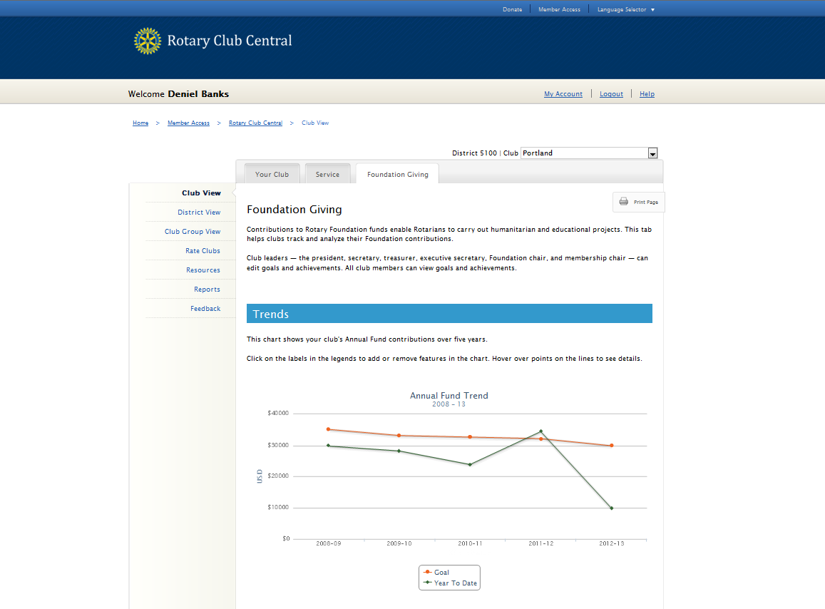
John Q. Rotarian
District: 0000 | Club: Your Club
Notes:
And lastly, on the Foundation Giving tab, this trend graph shows your club’s Annual Fund goals and giving over the last 5 years.
On all three tabs, you can view each trend graph in table form under each respective graph. These tables can be expanded out to show the numerical values for the last 5 years.

Slide 10
Foundation
791 USD
791 USD
Annual Fund Polio Plus Major Gifts and Benefactors
Notes:
Below the Annual Fund trends are the three main goals for Foundation giving:
(CLICK)
-The Annual Fund is broken out by Paul Harris Society, Sustaining Members, EREY, and other contributions.
-Then we have PolioPlus.
-And last we have Major Gifts and Endowment Fund, which includes Major Gifts, Bequest Society, and Benefactors.

Slide 11
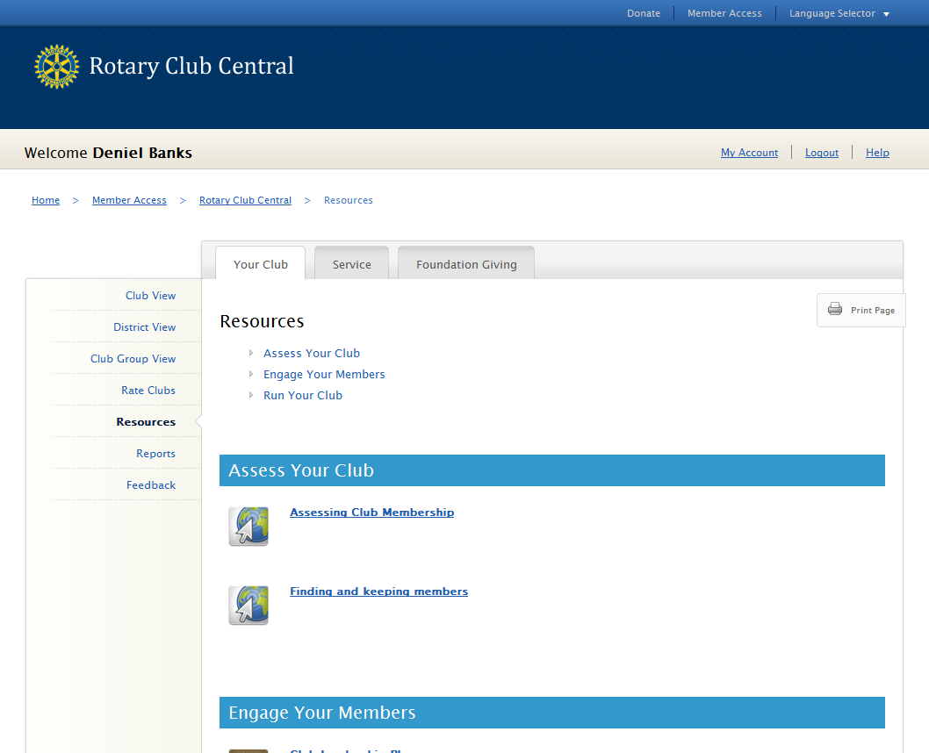
John Q. Rotarian
Notes:
Each tab has a link to resources on the left hand navigation bar.
(CLICK) This will give you access to publications, web pages, and even videos that can assist you in setting goals for your club.

Slide 12
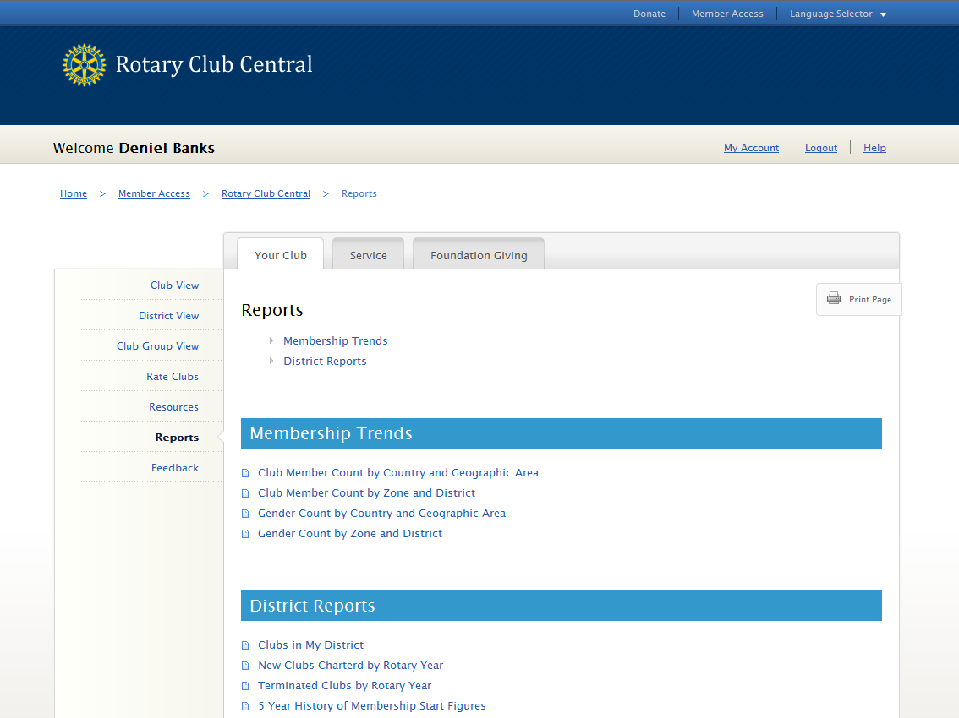
John Q. Rotarian
Notes:
On the left side beneath Resources, we have Reports.
(CLICK)
From here, you can view and download reports that are related to each of the three tabs. The reports you see will vary depending on your role.

Slide 13
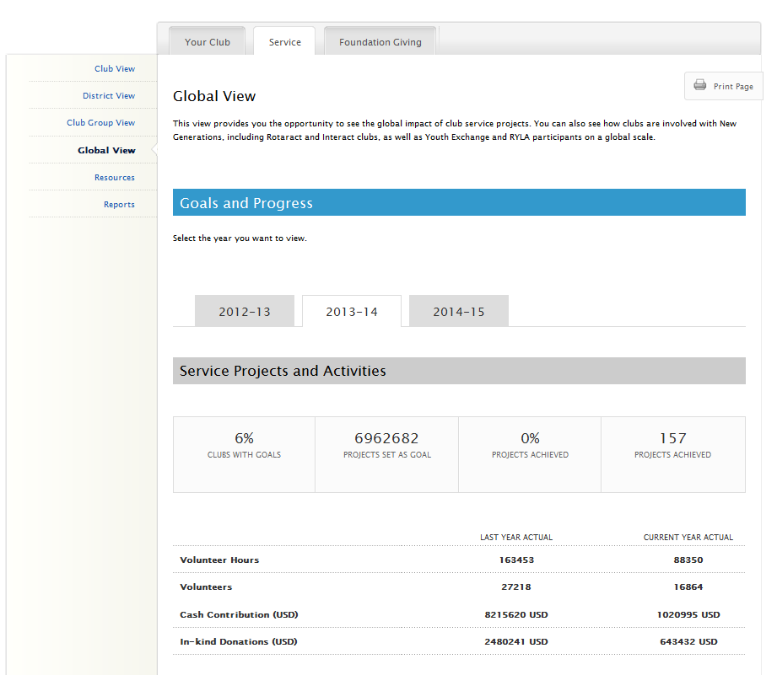
Notes:
As a club officer, most of your experience will be in the Club View, however, there are higher level views which can provide you with goal and progress summaries at the club group level, district level, and global level. Seeing the global view can give you a broader perspective of things like the number projects clubs are doing around the world, or the total number of Rotarians.

Slide 14
Introduction to Rotary Club Central
Entering Goals
District-level Features
Questions
Notes:
So, now that we’ve covered the basics, let’s talk about entering goals.

Slide 15
Who can enter goals?
CLUB LEVEL
President Secretary
Treasurer
Foundation Chair Membership Chair Executive Secretary
DISTRICT LEVEL
District Governor
*Assistant Governors Committee Chairs
Executive Secretary
Notes:
Everyone in the club can view goals, but who specifically can enter and edit goals?
(CLICK)
At the club level, the president, secretary, treasurer, Foundation chair, membership chair, and executive secretary can all enter goals for the year they are in office?
(CLICK)
At the district level, the district governor, committee chairs, and district executive secretary can view and edit the goals for all clubs in the district for their year. The assistant governors may view all goals but only edit the goals for the clubs in their club group. This is so district officers can assist a club with reporting its goals in case the club is unable to do so. When goals are set on behalf of a club, an automated email is generated and sent to the club president listing the goal change and who made the change.
Ideally, club officers will enter their club’s goals during their elect year.
(CLICK)
However, current, incoming, and immediate past officers can view all year tabs, and edit goals and achievements for their own year at any time (even after their year is over).
So, let’s take a look at two examples of a club entering a goal.

Slide 16
791 USD
791 USD
Notes:
In this example we’ll be entering a goal for Annual Fund, on the Foundation Giving tab. Anyone who can edit goals in that particular year will see an “EDIT” button.
(CLICK)
Everyone else will see “VIEW” which allows them to see the goals in more detail, but not add or change goals and achievements. So, let’s click “EDIT”

Slide 17
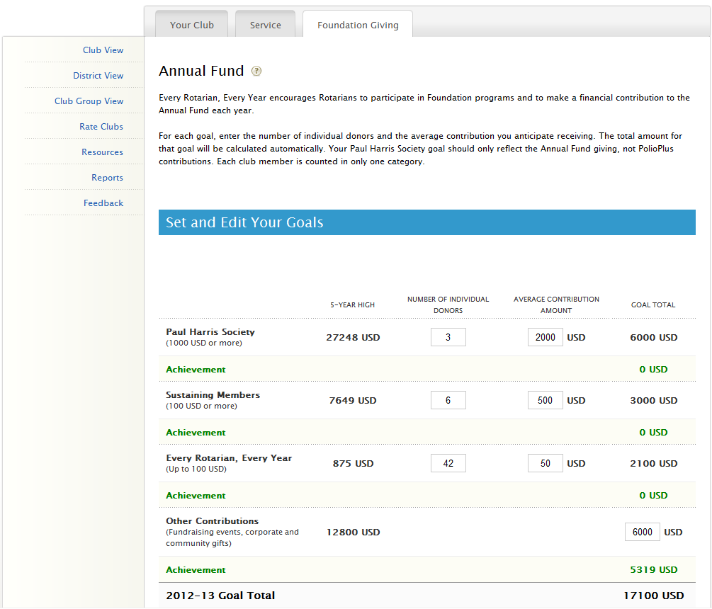
Notes:
From the edit page, you have instructions to help you fill out the supporting goals. For even more information you can click the question mark next to Annual Fund.
So, for this goal you will have to estimate a number of individual donors and then the average contribution amount for each goal level. As you fill in these sub-totals, you will see them automatically added to reflect your club’s total Annual Fund goal.
(CLICK)
Underneath each sub-goal is the club’s achievement towards that goal. You’ll notice this achievement information is automatically populated from Rotary International’s database and does not need to be entered by the user. This is updated daily.

Slide 18
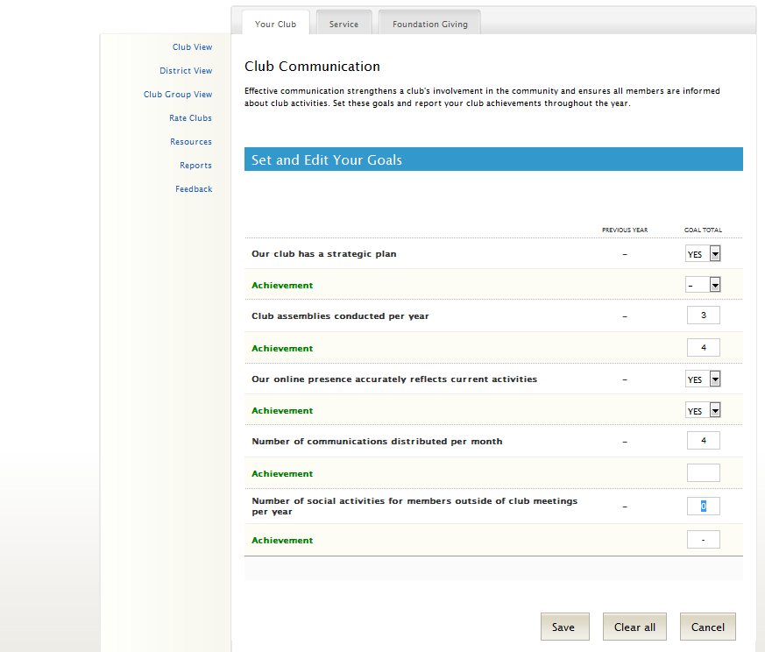
Numeric Monetary (USD) Percentage % Yes / No
Notes:
For the second example we use the Club Communication goal, found on the Your Club tab.
Some of these goals will require a value of YES or NO (such as “Our club has a strategic plan”), while others require a specific number goal (such as “the number of club assemblies conducted per year”)
(CLICK)
Unlike the previous example, these types of goals have self-reported achievements. Since RI does not collect this information, it is up to the officers to report their club’s achievement at the end of the Rotary year (or they may choose to update achievements periodically throughout the year).
Most of the goals in Rotary Club Central are entered in one of four ways. (CLICK) -There are numeric goals (for example, number of new members retained)
-Monetary goals (these are always in USD)
-Percentage goals (some goals provide the option of entering a percentage or numeric value)
-and Yes or No goals

Slide 19
Introduction to Rotary Club Central
Entering Goals
District-level Features
Questions
Notes:
At its heart, Rotary Club Central is a club-focused tool, however, there are some district-level features to help district officers assist clubs with their goals.

Slide 20
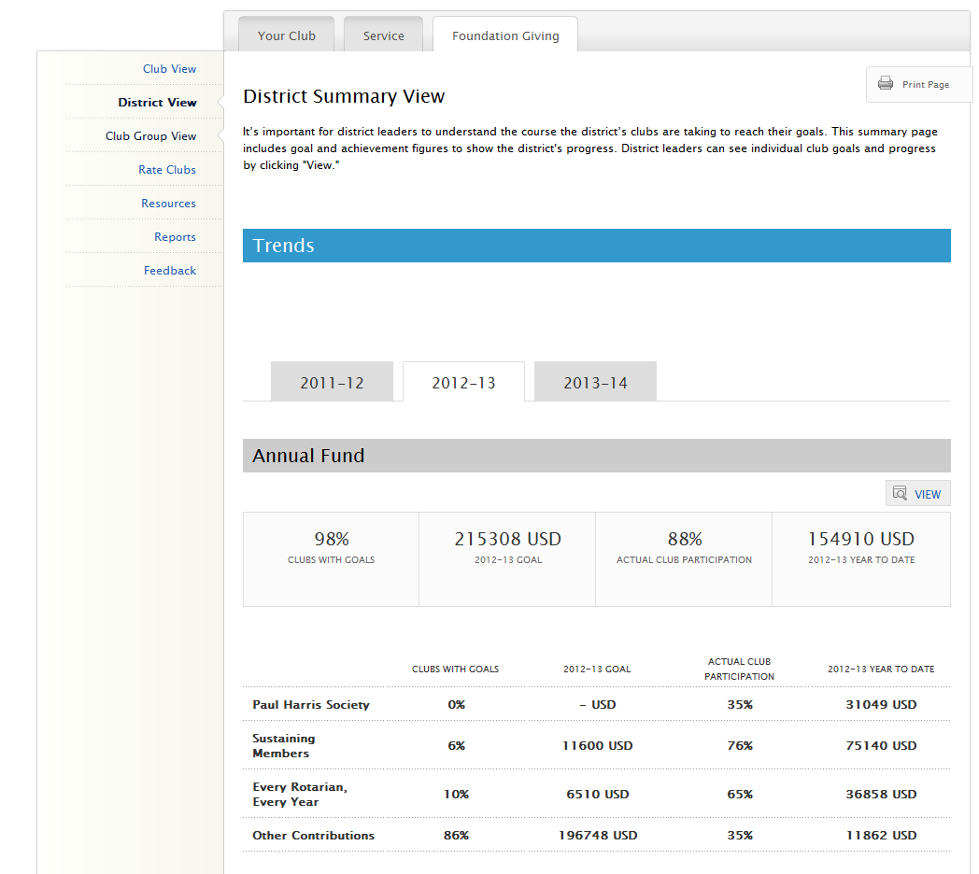
Notes:
The District View offers a summary of all goal and progress information for the district. (CLICK)
From this summary view, anyone can see the total % of clubs who have set a particular goal, the total goal for the district (based on clubs reporting), the percentage of clubs working towards achievement of that goal, and the total progress to date (for example, the total amount given to the Annual Fund from all clubs in the district). This can give the average club member or club leader an idea of how much their club is contributing to the total achievement of the district.
While all members can see the District Summary, district officers can go one step further by clicking “VIEW.” (CLICK)

Slide 21
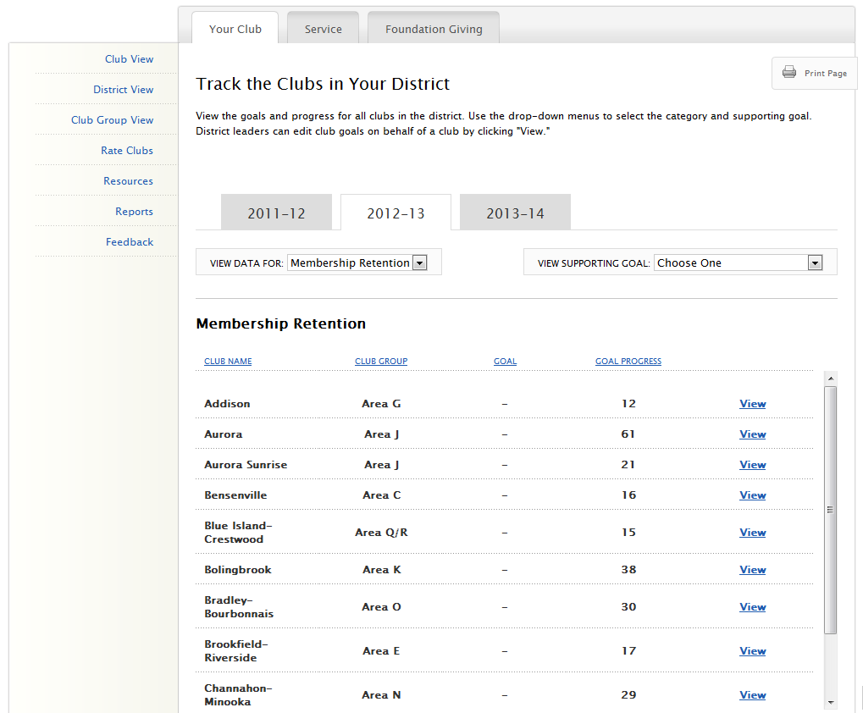
Atlantis
Atlantis Sunrise
Sesame Street
Gotham
Metropolis
Metropolis Sunset
Tattooine
Twin Peaks
Greendale
Notes:
From here, a district officer can see the progress of all the clubs in the district or choose a particular club to view their goals and achievements.
This helps you identify which clubs need more support and which are achieving their goals.
(CLICK)
You can use the two drop down menus to select a different major goal, and choose one of its supporting goals.
(CLICK)
Clicking “VIEW” will take you into the club view of that club where you can now view or edit that club’s goals.

Slide 22
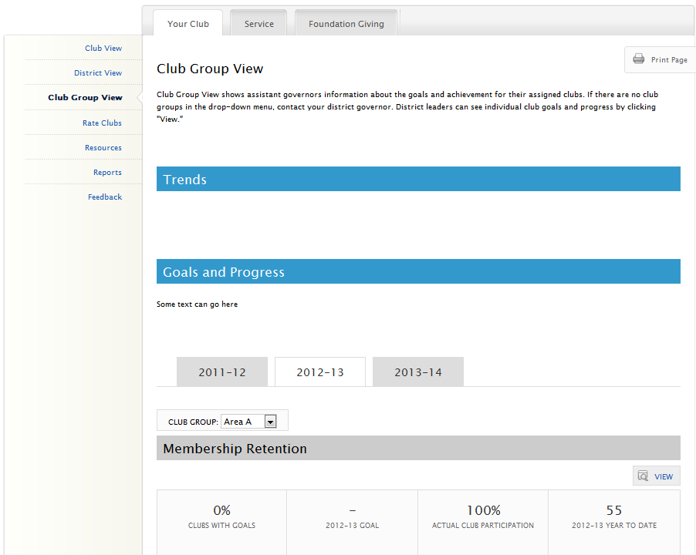
Notes:
Next, is the Club Group View. (CLICK)
All district leaders have this view, but it was designed specifically with assistant governors in mind. This is just like the district view except that it allows a district leader the ability to focus on one club group. When arriving at the page, AGs will see the club group they are assigned to while all other district leaders default to the first one in the drop-down menu.
(CLICK)
You can select a different Club Group from the drop-down menu to see the summary of that group.
Just like the District View, clicking “VIEW” here for any of the goals will take you to the listing of clubs in that group.

Slide 23
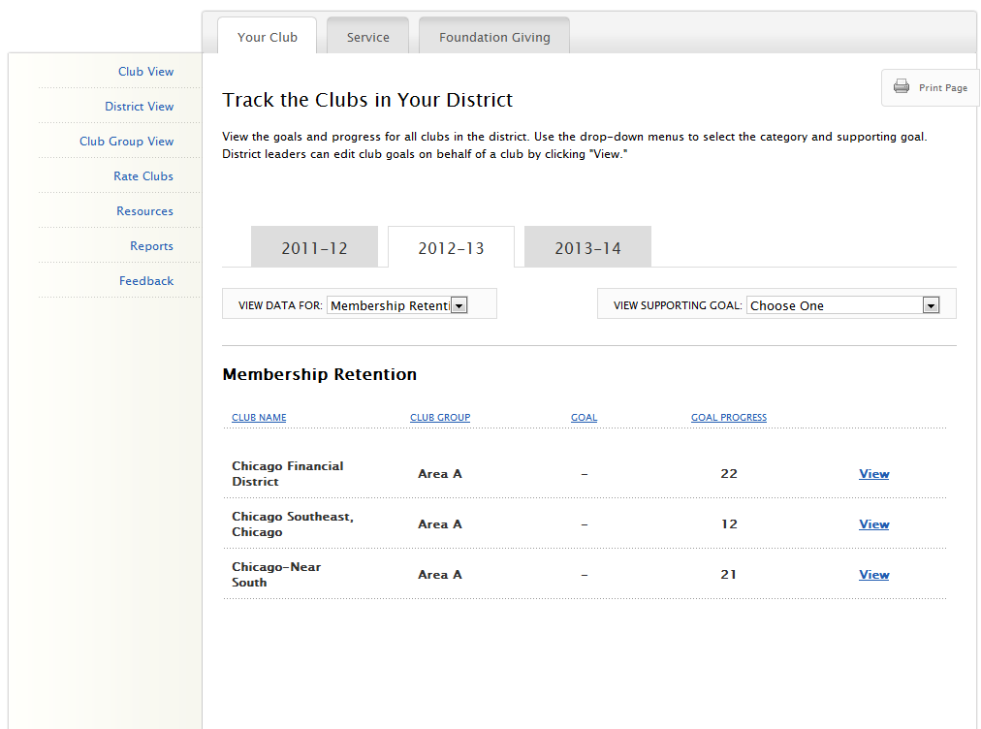
Metropolis
Twin Peaks
Greendale
Notes:
From here, you can see the individual goals and progress of the clubs in that club group. Clicking “VIEW” will allow you access to the club-level view so you can edit goals for that club.

Slide 24
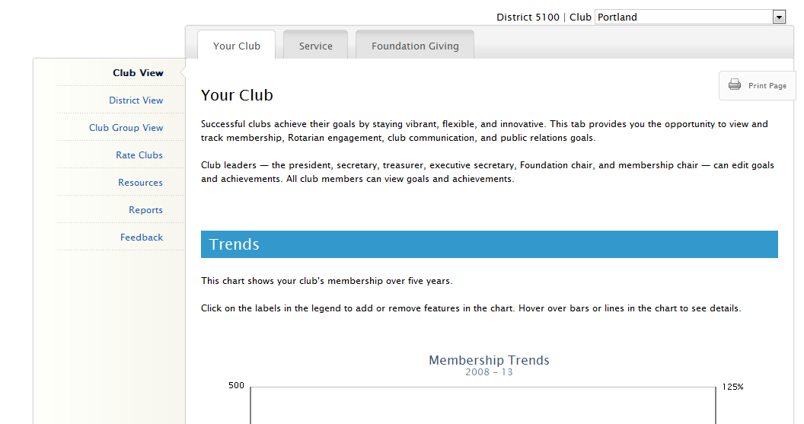
District: 0000
Notes:
As a district officer you also have the option to switch between different clubs from any page at the Club-View level.
In the right hand corner where it typically shows your club’s name, (CLICK) you will see a drop-menu which allows you to select any club in the district. This is a great alternative if you want to go directly to a specific club’s view without going through the District View or Club Group View.

Slide 25
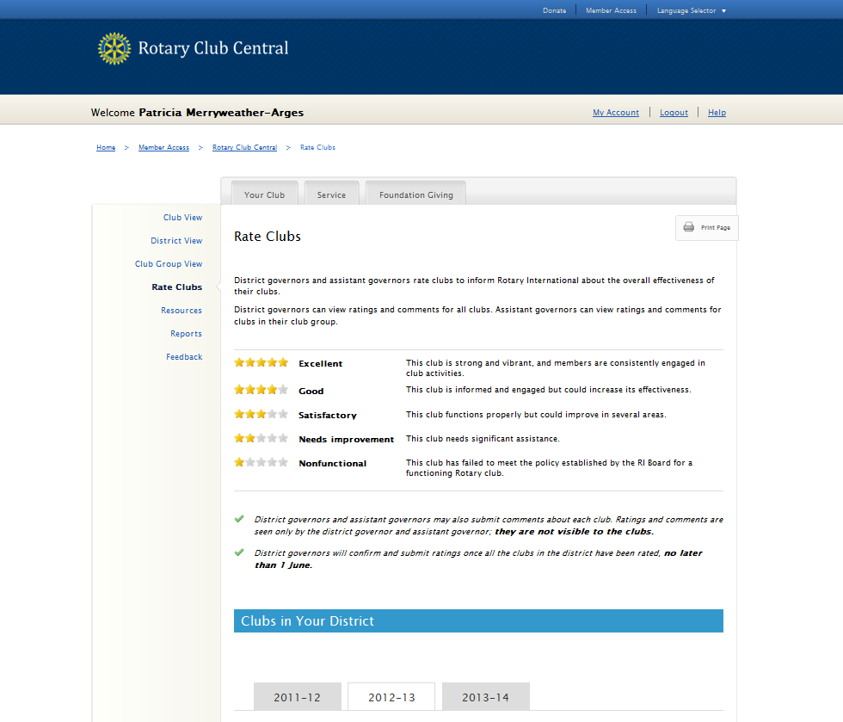
John Q. Rotarian
Notes:
(CLICK)
This is the Rate Clubs page which allows the district governor and assistant governors to assess club performance and provide comments. This replaces the Memos of Club Visit that are sent to RI towards the end of the governor’s year. Please note: only the governor, governor-elect, and immediate past governor can view all the club ratings under each year tab. The assistant governors can only see the ratings for the clubs in their own club group for their own year.
The page begins with an overview of what constitutes a 1 to 5 star club rating, which matches the criteria from the Memo of Club Visit.

Slide 26
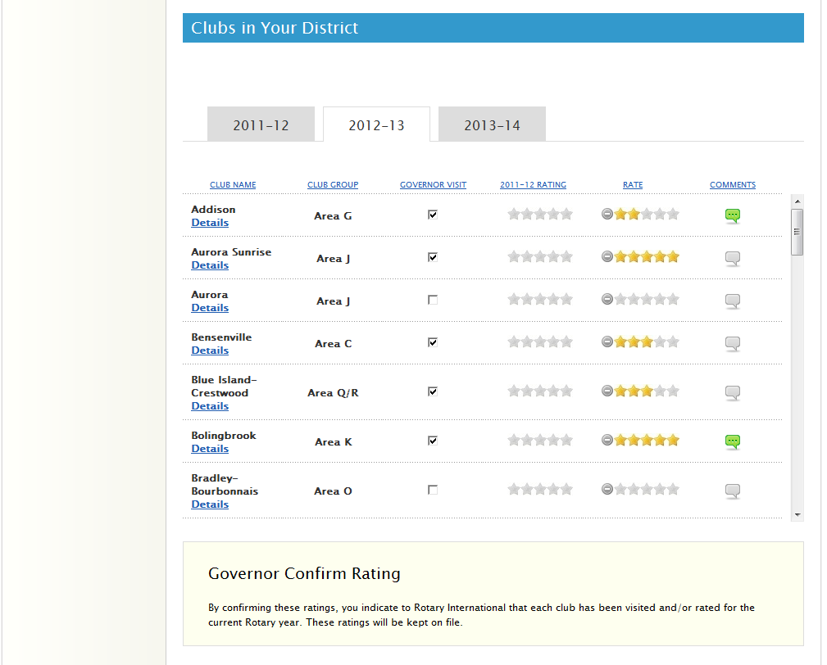
Atlantis
Atlantis Sunrise
Sesame Street
Gotham
Metropolis
Twin Peaks
Greendale
Notes:
Scrolling down further, both the DG and AGs can rate clubs 1 to 5 stars and leave comments. Ratings can be changed at any time by both the AG and DG. The comment field can be used to explain the reason for a change in a club’s rating or provide details about a club visit.
The governor can also indicate that the Governor visit was completed by checking the box for each club.
At the end of the year, when all clubs have received their final ratings, the district governor will confirm the rating. This freezes all the ratings and fulfills the governor’s duty of submitting the Memo of Club Visit to RI.

Slide 27
Introduction to Rotary Club Central
Entering Goals
District-level Features
Questions
Notes:
Now, we have time to answer any questions you may have. (CLICK)

Slide 28
Questions?
Notes:
(Answer any questions possible)
For more specific details about each goal and achievement, please refer to the Club Reference Guide. The District Reference Guide provides further information about the district-level features we’ve covered. These are both available in the Learn module at the MyRotary website.
Any additional questions can be directed to the Contact Center or your Club and District Support Representative.
Thank you.

