Slide 1
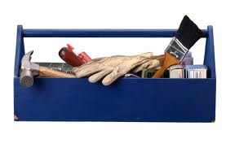
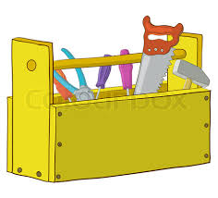
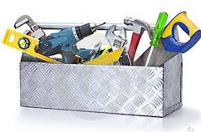
Tool Library Project
Tool Library Project

Slide 2
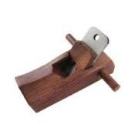
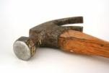
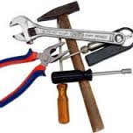
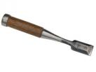
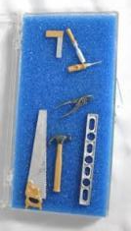
CARPENTERS TOOL BOX | Quantity
Hammer | Pcs
2. Carpenter’s square | Pcs
3. Measuring Tape | Pcs
4. Aluminum Level | Pcs
5. Pliers | Pairs
6. Screw Driver Sets | Sets
7. Hacksaw | Pcs
8. HandSaw | Pcs
9. C-clamp | Pcs
10. Adjustable Wrench | Pcs
11. Chisel | Pcs
12. Gloves & Hard Hats | Sets
13. Hand Riveter | Pcs
14. Chalk Line | Pcs
15. Tool Box | 1 Pc
TOTAL COST | 12,600.00
US $ 300.00

Slide 3
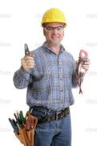
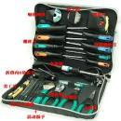
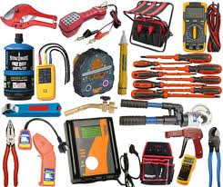
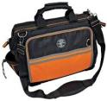
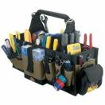
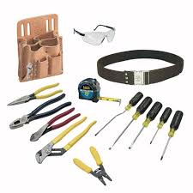
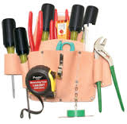
ELECTRICIANS TOOL BOX | QUANTITY
1 Combination Pliers | 5 prs
2 Long Nose Pliers | 5 Prs
3 Diagonal Cutting Pliers | 5 Prs
4 Drill Bits | 1 set
5 Cutter Blade | 10 pcs
6 Multi Tester | 1 unit
7 Tex Screw Adaptor | 5 pcs
8 Electric Drill HD | 1 Unit
9 Tool Box | 1 pc
TOTAL
 | 12, 600
US$ 300

Slide 4
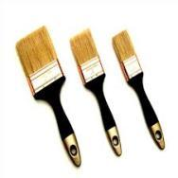
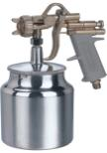
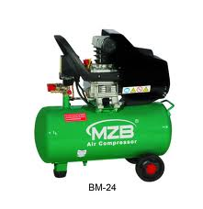
PAINTING WORKS TOOL BOX | QUANTITY
1 Air Compressor | Unit
2 Spray Gun | Pcs
3 Paint Brushes | Lot
4 Roller Blade with Handle &Tray | Lot
5 Tool Box | Pc
TOTAL | 12, 600
US$ 300

Slide 5
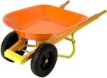
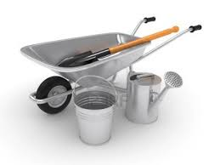
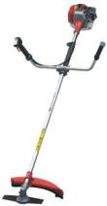
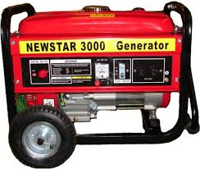
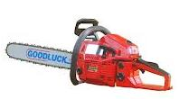
Other MAJOR ITEMS | AMOUNT
1 Chain Saw | 1 unit
2 Bush Cutters | 1 unit
3 2.5HP Generator | 1 unit
Expandable Ladder 10-17ft | 1 unit
Shovels | 5 pcs
Rake | 5 pcs
7 HD Extension Cord | 1 Unit
8 Wheel Barrow HD | 1 Unit
9 Tool Box | 1 pc
TOTAL | 77,700
US$ 1,850

Slide 6
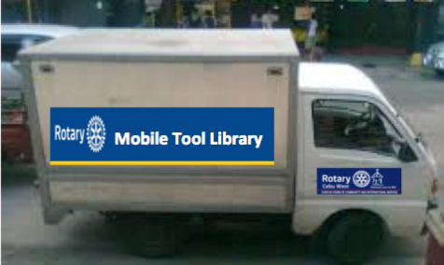
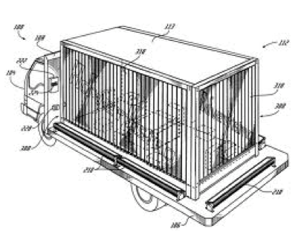
For MOBILITY
A Custom Made Van
US$ 5,500

Slide 7
Tool Library Project
PROJECT COST | Cost
1 Carpentry & Plumbing | $ 300
2 Electrician Box | $ 300
3 Painting Works | $ 300
4 Other MAJOR Items | $ 1,850
5 Mobility Van | $ 5,500
6 Fuel & Project Markings | $ 750
TOTAL PROJECT COST | $ 9,000

Slide 8
Tool Library Project
How does it work?
To make TOOLS available to the village/community to help them re-build their homes.
After use, the TOOLS will then be collected by the Re-Habilitation committee for future use of other villages.
The Committee will keep track the INVENTORY.
SPONSORSHIP OPTIONS
Stage 1
Ideally, a CLUB or INDIVIDUAL or GROUP OF CLUBS may sponsor (1) whole lot of MOBILE TOOL LIBRARY Including the custom made VAN. Total Costs $ 9,000.
Sponsoring Club’s name will be included in the body design of the Van promoting ROTARY.
Stage 2
If we are able to complete 1 whole lot of MOBILE TOOL LIBRARY, other interested sponsors may add additional box of their choice ($300) ($1850) or another whole set ($9000).

